Slide 1



Predicting Financial difficulty and hardship with machine learning AT anz
Project Presentation
Presented by Ally Hassell

Slide 2
Scope
Notes:
Three sections: Why, how, what it showed

Slide 3
aNZ Project proposal
Good Customer Outcomes team wanted to explore the use of advanced data analytics and machine learning to improve customer outcomes.
Constraint: avoid topics already researching
Best way to leverage the data? Financial difficulty and hardship.

Slide 4
Financially struggling
Difficulty (4,000 people a year)
Missing repayments
Excess arrears
Marginal transactional history
Financial hardship (450 people each year)
Risk of defaulting
Why this topic?
Often, customers aren’t going to tell their bank if the are struggling financially
Psychological barriers like shame, fear etc.
Currently experiencing, no warning

Slide 5
Research goal
Objective
Use ANZ’s large amount of financial data to engineer new features, and use these to train a machine learning model to predict financial difficulty and hardship.
Why
Currently, ANZ can only identify customers who are already experiencing difficulty and hardship. If financial issues can be predicted then ANZ can provide pre-emptive support to help customers prevent this unfavourable outcome.

Slide 6
ethics
Privacy - ANZ privacy statement
Informs customers it will analyse data and generate insights
Customers can review and correct their personal data
Legal contract signed when opening account
Privacy - During data analysis
Anonymized with ID numbers
Rules and procedures to protect data
Not used for anything which would violate their rights
Use of model
Handed off to Good Customer Outcomes
Proof of concept and not in production
Only accessible to people who understand the contents

Slide 7
Methodology

Slide 8
METHODOLOGY
Exploration
Feature engineering
Machine learning
Results analysis
- Scope
- Data exploration
- Feature ideas
- Extract
- Manipulate
- Transform
- SAS/SQL
- Trail models
- Test/train
- Python
- Features importance
- Patterns
- What does this mean?
- Apply insights

Slide 9
exploration
Data
New features
Customer information 1.9 million
Transactions 450 million
Credit cards 230 million
Financial hardship labelled
Expense categories credit
Expense categories debit
Spending velocity: how fast a customer spends 75% of their income.
Pay later: number and amount spent through pay later schemes (Afterpay and PayPal).
Credit card: spending credit on discretionary or necessities.
Notes:
Customers: 1.9 million
Transactions: 450 million
After-pay: 6 million
Creditcard transactions: 230 million

Slide 10
Feature engineering and Wrangling
Programming
Code: SAS software using SQL queries
Retrieving from Teradata
Wrangling using methods such as retrieval, transforming, merging, manipulating and consolidating.
Timeline
Collect 6 months from date of difficulty/hardship or today
Each feature was collected for three intervals two months from this date
Feature reduction (went from 234 to 47)
Correlation
Overlapping values
Reduced timescale
One row for each customer
Notes:
Number of features used in final table was xxx, and number

Slide 11
Machine learning
Step 1) Performance metrics
F1 score because it optimises recall and precision
Recall and precision
Step 2) Many models were trained
Why? Gain an idea of what models performed best
Models trialled were: decision trees, random forest, LDA, SVM, Naïve Bayes, quadratic discriminant classifier, logistic regression, KNN, extra trees
Python package called lazytrain
Step 3) Detailed machine learning models
Took best model from trials and ran more detailed machine learning code
Used Python PyCaret package
Ten-fold cross validation

Slide 12
Results

Slide 13
Best performing Models
 | Model | F1 score | Recall | Precision
Difficulty | Random forest | 0.689 | 0.567 | 0.872
Hardship | Extra trees | 0.059 | 0.0315 | 0.172

Slide 14
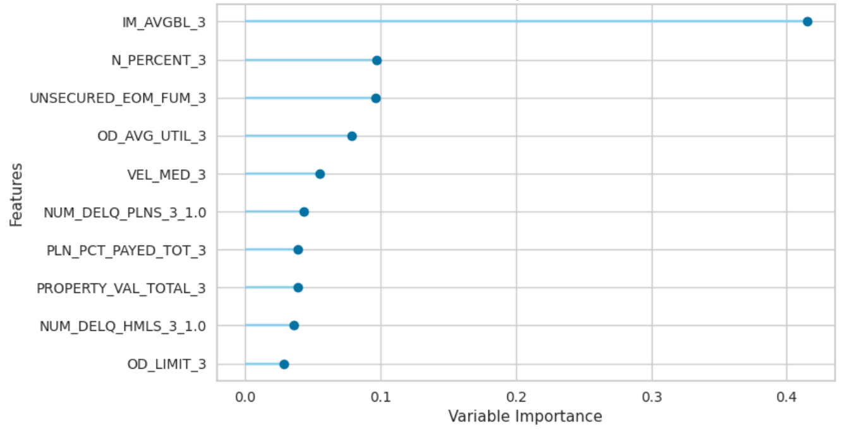
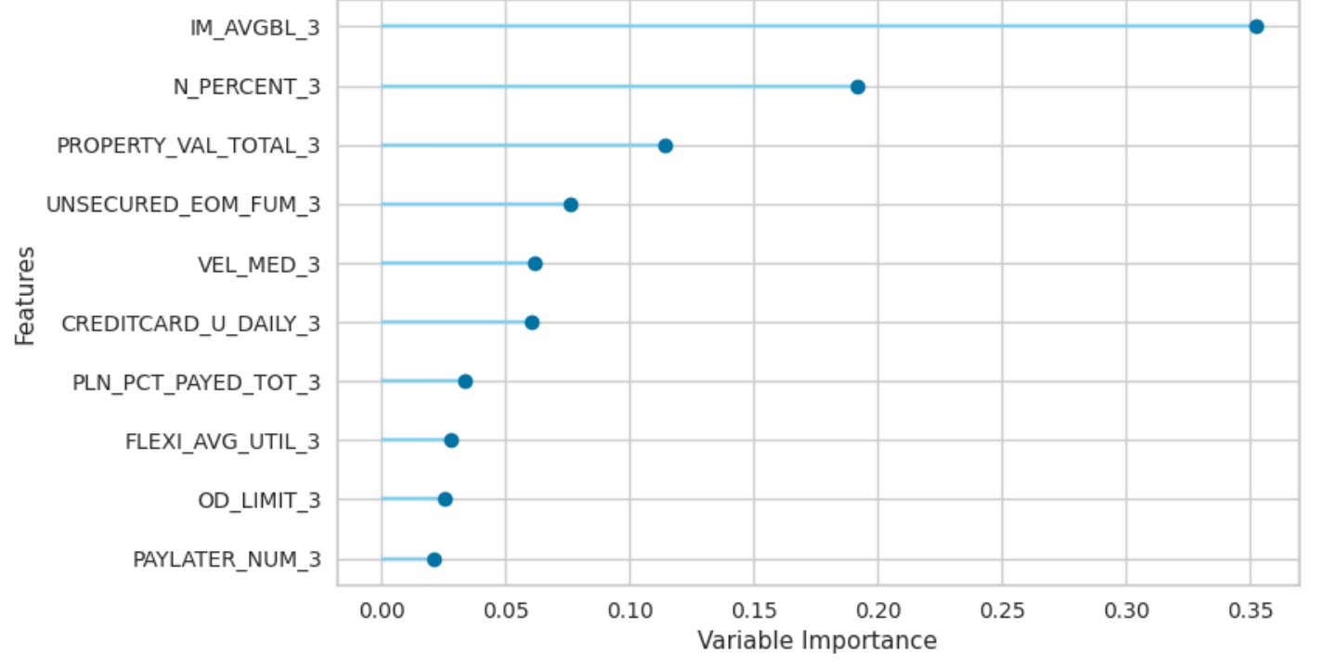
Difficulty - random forest model
Important features
Confusion matrix
 |  | Actual
 |  | Positive | Negative
Predicted | Positive | 7,153 | 1,049
 | Negative | 5,462 | 1,881,137

Slide 15
hardship - random forest model
Important features
Confusion matrix
 |  | Actual
 |  | Positive | Negative
Predicted | Positive | 47 | 226
 | Negative | 1,452 | 1,894,575

Slide 16
conclusionS
Successful proof of concept
Financial difficulty could be possible to predict to a useful level of accuracy.
Hardship predictions were more inaccurate and may not be predictable to a satisfactory level.

Slide 17
Conclusions
Next steps – improve accuracy and validate results
Class imbalance - over and under sampling, class weights
Time series cross validation
Employ more computing power
Only used past two years of data – use more historical data
Efficiency of code
Tune model
Validate results with new incoming data
Add new features – percent income spent on accommodation
Exploratory data analysis
Run cost/benefit analysis for ANZ
If validated and improved it could be used by the Good Customer Outcome team to improve the financial wellbeing of ANZ customers.

Slide 18
THANK YOU
Presented by Ally Hassell

